Slide 1
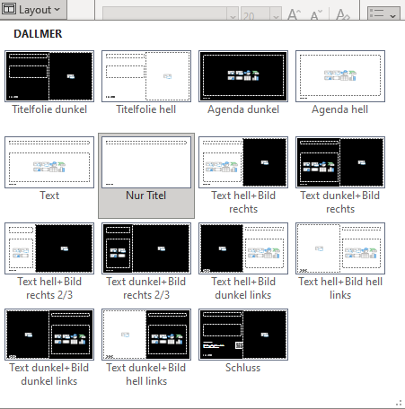
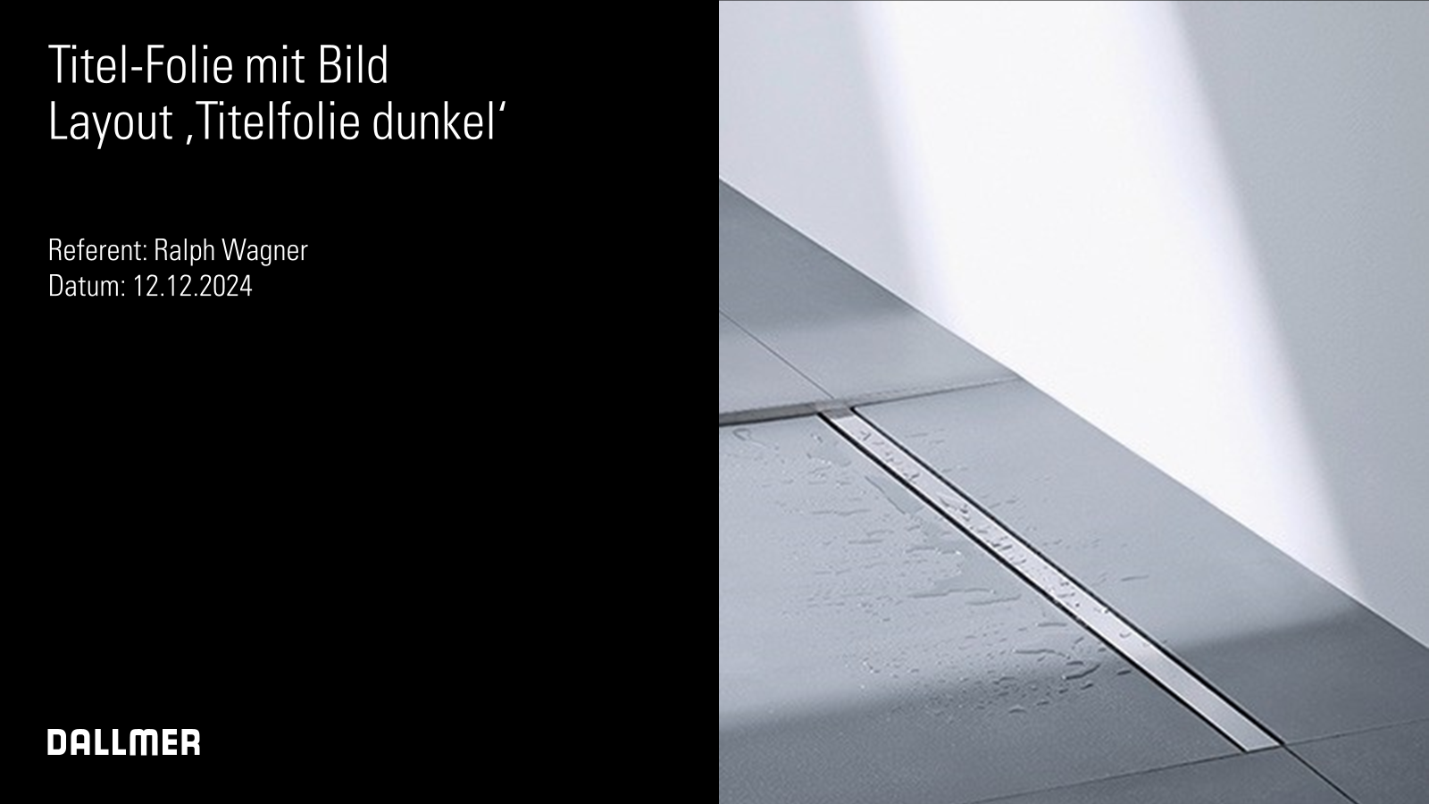



Quick guide (1/6)
Always use the predefined layouts
Multifunctional layouts
The layouts created with image placeholders can be used multiple times:
Click on Layout to change the layout on an existing page. page.
1.
With picture
Click on New slide to select different layouts.
2.
Without any other elements
Click on the Reset button to reset the appearance of the page according to the template to the original layout. layout according to the template.
3.
With graphic elements/ Illustrations

Slide 2

Quick guide (2/6)
Preconfigured text placeholders The text placeholders are preset with the corporate font Univers LT Std 47 Cn Lt preset:
List level for text placeholders / selection of different font styles
To change the font styles on the text pages with placeholders, use the text pages with placeholders, use the buttons List level increase/decrease Do not create your own bullet points.
First levels: 20pt, (indent bullet)
Second level: 20pt, (indent bullet)
Third level: 20pt, (indent bullet)

Slide 3
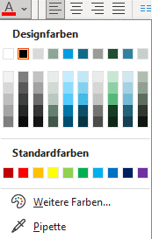
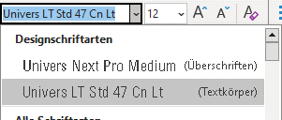

Quick guide (3/6)
Colors
Writings
Examples of standard shapes, lines and text fields
To color objects, please use the defined design colors in the first line.
The use of standard colors is not desired.
In PowerPoint presentations, the font used is Univers LT Std 47 Cn Lt (body text) and Univers Next Pro Medium Cond (headings) for highlighting. Please do not use BOLD!
Standard form
These colors may not be used
Font size 20 pt
Color blue Without line
These colors may not be used
Standard text field
Standard line
Line .75 pt, black

Slide 4
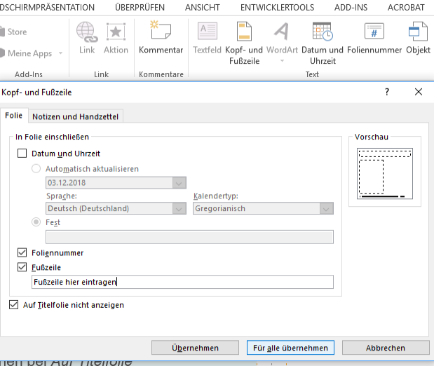
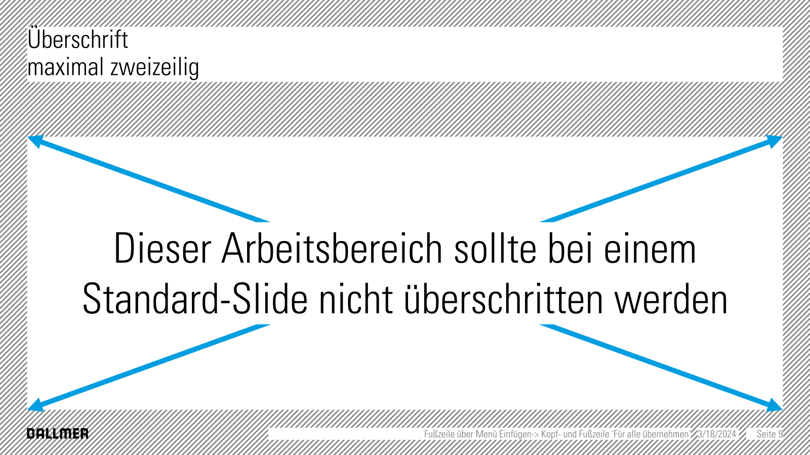
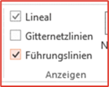
Quick guide (4/6)
Header and footer / page numbers
1
Ruler and guide lines
Menu Insert/Header and Footer.
Enter footer
Check mark for slide number
Tick "Do not display on title slide"
Click for all.
In the View menu, place a checkmark next to Ruler and guide lines.
IMPORTANT: If old presentations are copied in, page numbers or footers sometimes appear in the wrong place or formatted incorrectly. To avoid this, repeat twice until after the presentation has been completed: first remove all check marks and click "Apply to all" and then check the boxes again. This ensures that all settings are applied correctly.
1
3
2
3

Slide 5
Quick guide (5/6)
Diagrams
Tables
Dos and Don'ts
Diagrams are 2-D and are automatically created by PowerPoint. Adjust the font size and colors to your requirements.
Tables are preset as below.
Only the header needs to be adjusted manually: Font 'Univers Next Pro Medium', Customize everything else (font size, alignment, etc.) to your requirements.
Do NOT use special effects such as mirroring or 3D effects! Do NOT use colors outside of the CD.
Text | Text | Text | Text | Text
Text | Text | Text | Text | Text
Text | Text | Text | Text | Text
Text | Text | Text | Text | Text

Slide 6

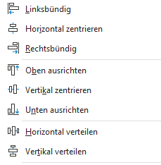
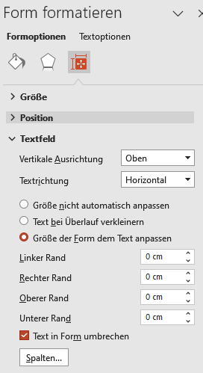
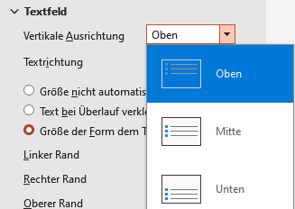
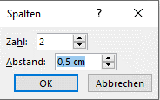
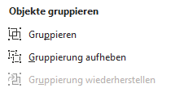
Quick guide (6/6)
Using alignment tools
Format shapes
Align objects Select the objects that you want to align. Go to Start and click on Arrange. Select Align and the desired alignment options.
Text field and shapes Each shape is also a text field and can be labeled.
Straight line, circles and squares To draw a straight line, a circle or a square, hold down the Shift key while drawing.
DO NOT use text field AND form

Distribute horizontally or vertically
This function distributes the distance between different objects evenly. Select the objects you want to adjust (at least three) and select Distribute horizontally or Distribute vertically.
Text alignment and inner margins To design shapes and text fields according to your wishes, use the: Vertical alignment
Columns
Longer texts are easier to read if they are arranged in columns.
In addition, more text often fits into the available space.
Inner edges
Group objects
Use this function to group boxes
Wrapping text in form is sometimes not useful

