Slide 1
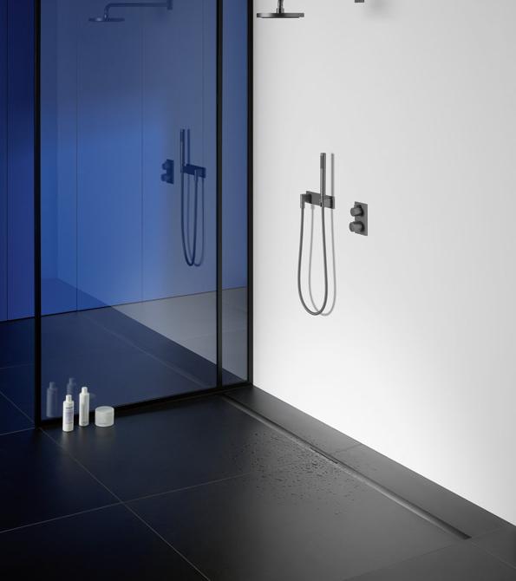
Company presentation

Slide 2
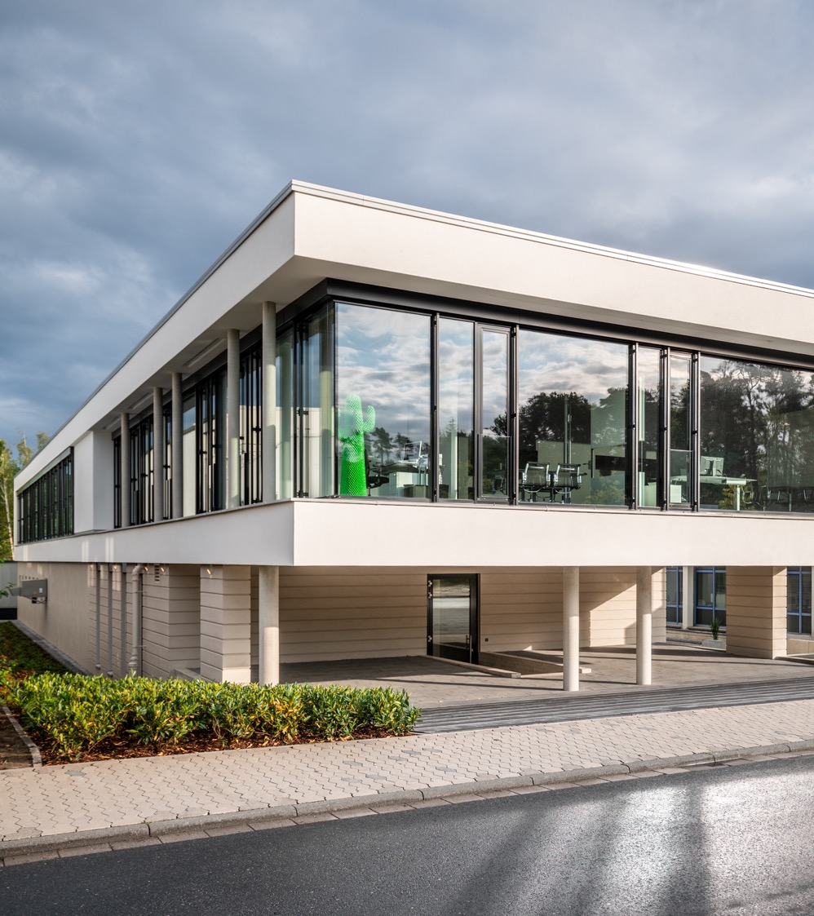
Made in Arnsberg
The Dallmer family business is now in its fourth generation with more than 200 employees.
All Dallmer products are developed, designed and manufactured using state-of-the-art technology in Germany – more specifically, in Arnsberg.
The "Made in Germany" seal of quality applies without reservations.

Slide 3
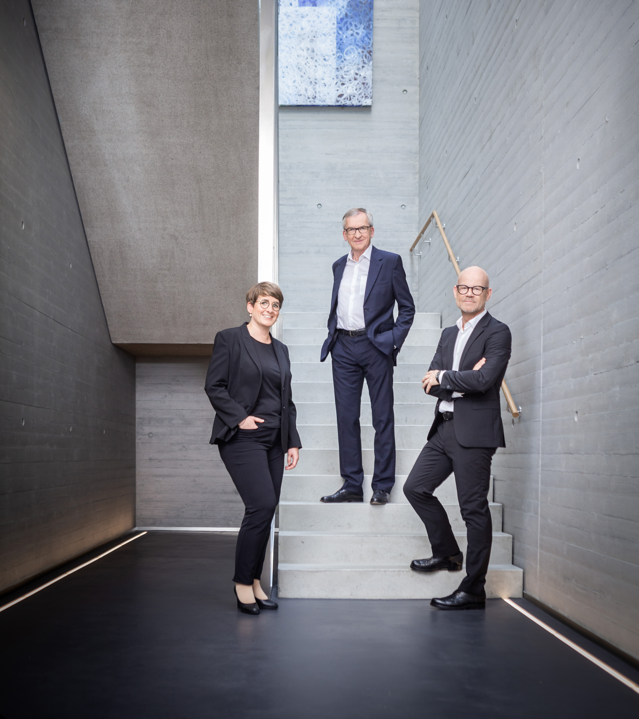
Made in Arnsberg
„We are an innovative company – but we're also one big family."
Harry Bauermeister, Managing Director
Yvonne Dallmer, Johannes Dallmer, Harry Bauermeister

Slide 4
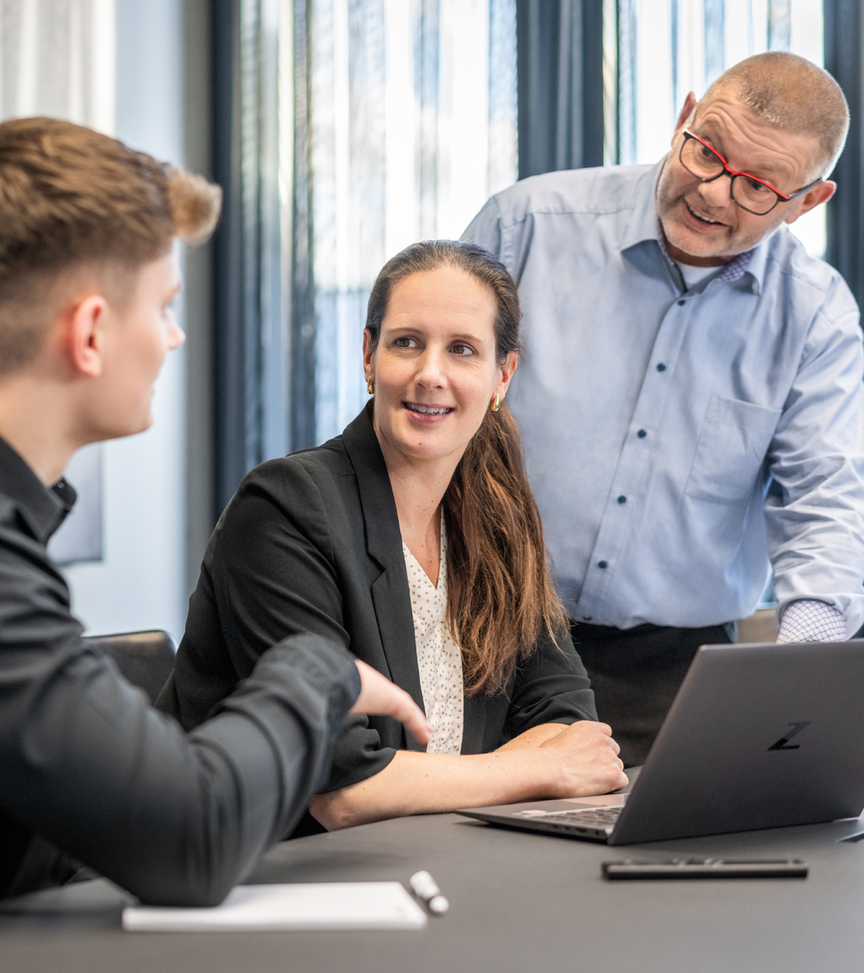
Made in Arnsberg
Investing in the future. Dallmer does not only invest money in state-of-the-art machine technology, but also in training and further education for its employees. This ensures that there is specialist know-how at the location.
Bringing together strengths. In order to produce drainage solutions which set standards, you need a genuine innovative spirit and a high degree of experience – and state-of-the-art technology.
Every detail counts. Quality is our top priority. If we all work towards this same goal, we are capable of meeting even the highest demands.

Slide 5
Made in Arnsberg
111
The story of Dallmer began 1913 in Neheim, today Arnsberg. Founded by master engraver Johannes Dallmer, Sr, the company was originally committed to the production of stamps, imprints, and fine engraving work on lights.
4
Yvonne Dallmer joins the company in the 4th generation. Her passion for architecture and design makes the brand unmistakable.
16
Dallmer now has 16 sales offices in Germany, and exports are also growing.
10
10-year warranty: innovative and safe drainage technology at the highest level can be realized with our products. We have much to thank our clients for, who continue to give us incentives for new developments and this is our way of saying thank you! With a promise that you can extend to your customers: a 10-year warranty on Dallmer products.

Slide 6
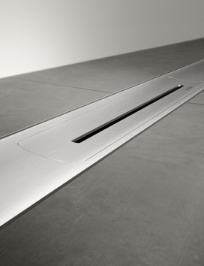
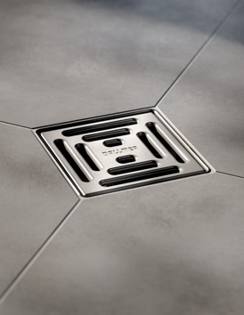
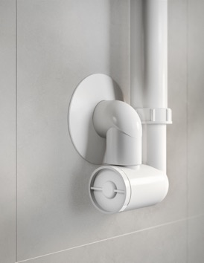
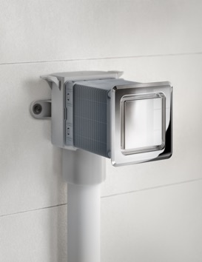
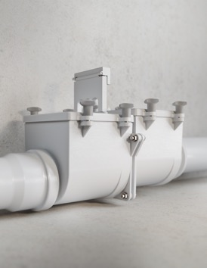
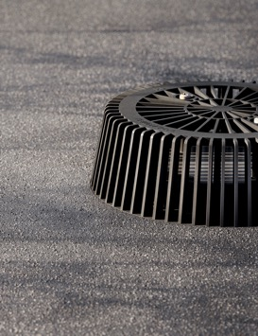
Made in Arnsberg
Shower channel systems
The versatile shower channel systems from Dallmer stand for excellence across the board, and create bathrooms without limits.
Floor drain systems
Dallmer offers attractive and innovative point drains for the drainage of floors, bathrooms and level-access showers.
Shower traps and traps
State-of-the-art drainage technology: maximum flexibility shower tray drains and traps for every application.
Air-admittance valves
Advanced technology, compact design: As well as the technology, it is also about how the air-admittance valves blend into the bathroom harmoniously.
Cellar drains and anti-flooding valves
Underneath the backflow level, anti-flooding valves and cellar drains with anti-flooding valves ensure safe drainage.
Roof and balcony drains
Technically sophisticated solutions for flat roof drainage and renovation as well as for balcony drainage.

